Slide 1

Strings in .NET
Gérald Barré
Website: https://www.meziantou.net
Twitter: @meziantou

Slide 2
Quiz
What output the following code?

Slide 3
Quiz
What output the following code?
=> It depends
 | Windows | Linux
.NET Core 3.1 | True | False
.NET 5.0 | False* | False
*depends on configuration NLS/ICU
Note: Can change at any time

Slide 4
Unicode

Slide 5
Unicode – Characters
Unicode provides a unique number (Int32) for every character
“a” U+0061 (Latin Small Letter A)
“é” U+00E9 (Latin Small Letter E with Acute)
“!” U+0021 (Exclamation Mark)
“你” U+4F60 (CJK Unified Ideograph-4F60)
“😊” U+1F60A (Smiling Face with Smiling Eyes)

Slide 6
Unicode – Grapheme clusters
One “character” may be a combination of multiple characters
“é”
  U+00E1 Latin Small Letter E with Acute
“é” looks the same as “é” but is represented by two characters
  U+0065 Latin Small Letter E
  U+0301 Combining Acute Accent
“👩🏽‍🚒”
  U+1F469 Woman
  U+1F3FD Emoji Modifier Fitzpatrick Type-4
  U+200D Zero Width Joiner
  U+1F692 Fire Engine

Slide 7
Normalization form
Different ways to represent the same string
  Form C: minimal
    U+0065 U+0301 => U+00E1
  Form D: expanded
    U+00E1 => U+0065 U+0301

Slide 8
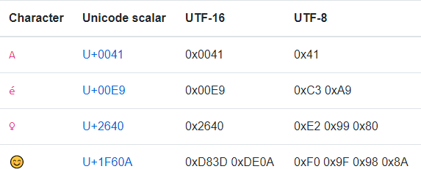
Unicode - Encodings
A Unicode transformation format (UTF) maps a character to bytes
  UTF-8: 1, 2, 3, or 4 bytes per character
  UTF-16: 2 or 4 bytes per character
    High / Low surrogate when 4 bytes
  UTF-32: 4 bytes per character

Slide 9
.NET Types
System.Rune ⬄Unicode Scalar Value (32 bits)
System.Char (char) ⬄ UTF-16 Code Unit (16 bits)
System.Text.StringInfo ⬄ Grapheme clusters
System.String (string) ⬄ System.Char[] (immutable)

Slide 10
How to count characters?
Number of UTF-16 code units
  "👨‍👩‍👧‍👦".Length => 11
  (D83D, DC68), 200D, (D83D, DC69), 200D, (D83D, DC67), 200D, (D83D, DC66)
Number of Unicode Scalar Values
  "👨‍👩‍👧‍👦".EnumerateRunes().Count() => 7
  U+1F468, U+200D, U+1F469, U+200D, U+1F467, U+200D, U+1F466
Number of grapheme clusters
  new StringInfo("👨‍👩‍👧‍👦").LengthInTextElements => 1

Slide 11
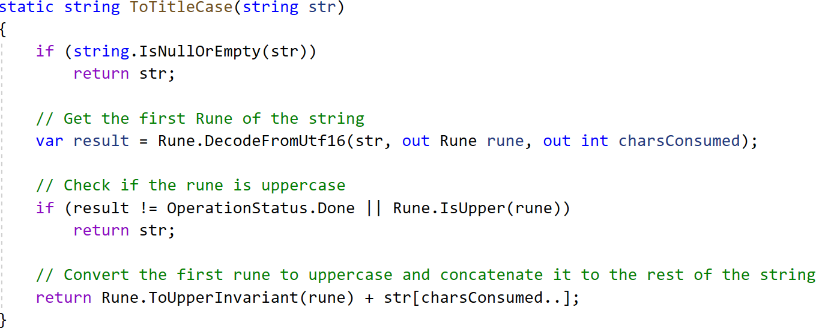
Convert to Title Case

Slide 12
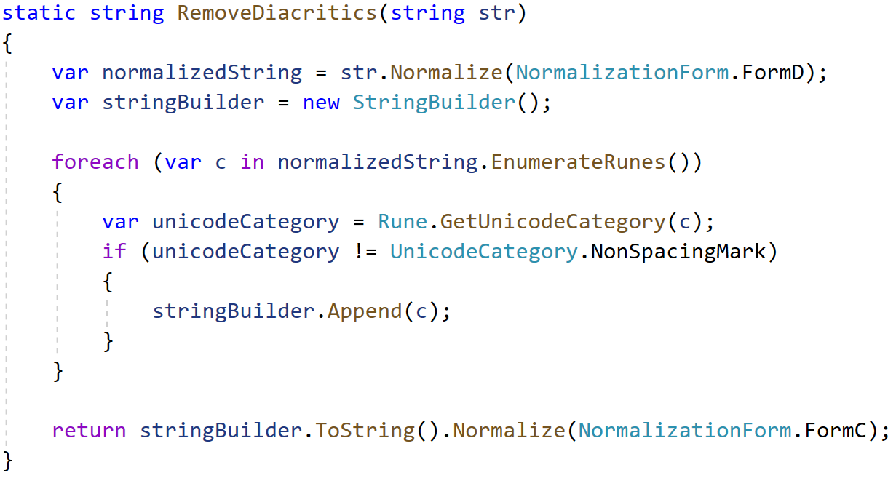
RemoveDiacritics

Slide 13
String comparisons

Slide 14
String comparisons
StringComparison.Ordinal
StringComparison.OrdinalIgnoreCase
StringComparison.InvariantCulture
StringComparison.InvariantCultureIgnoreCase
StringComparison.CurrentCulture
StringComparison.CurrentCultureIgnoreCase

Slide 15
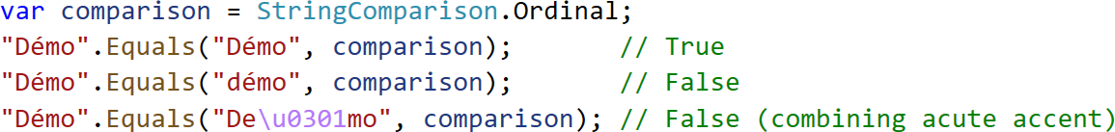
StringComparison.Ordinal
Compare the raw data byte per byte

Slide 16
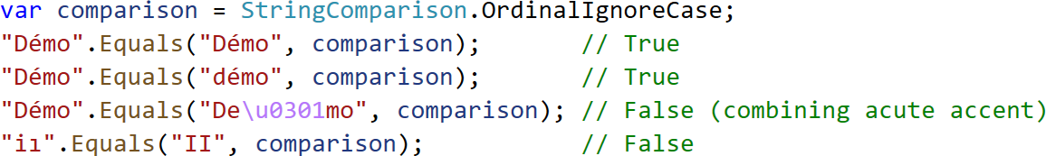
StringComparison.OrdinalIgnoreCase
Compare data as if both strings were changed using ToUpperInvariant
  ASCII characters: [a-z] => [A-Z]
  Non-ASCII characters: special cases for a few alphabets

Slide 17
StringComparison.InvariantCulture / StringComparison.CurrentCulture
Compare strings using culture-sensitive sort rules
Depend on the localization data
  NLS on Windows from .NET 1.0 to .NET Core 3.1
  ICU on Windows starting with .NET 5.0 (possible to use NLS using DOTNET_SYSTEM_GLOBALIZATION_USENLS)
  ICU on Linux
Localization data are not constant (Windows / .NET updates)
.NET 5 allows using App-local ICU
Notes:
https://docs.microsoft.com/en-us/dotnet/standard/globalization-localization/globalization-icu
https://github.com/dotnet/runtime/discussions/43911
NLS: National Language Support
ICU: International Components for Unicode

Slide 18
String comparison examples

Slide 19
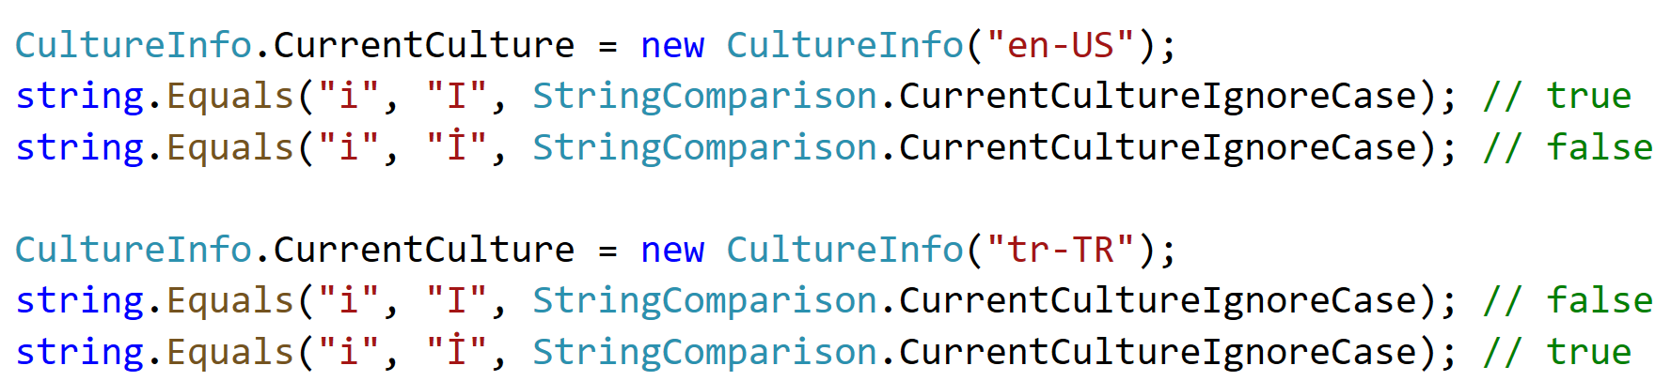
String comparison examples

Slide 20
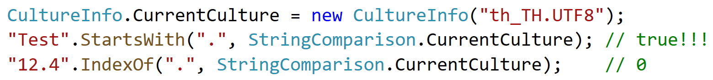
String comparison examples
Be careful when searching for file extensions in the “th_TH.UTF8” culture:

Slide 21
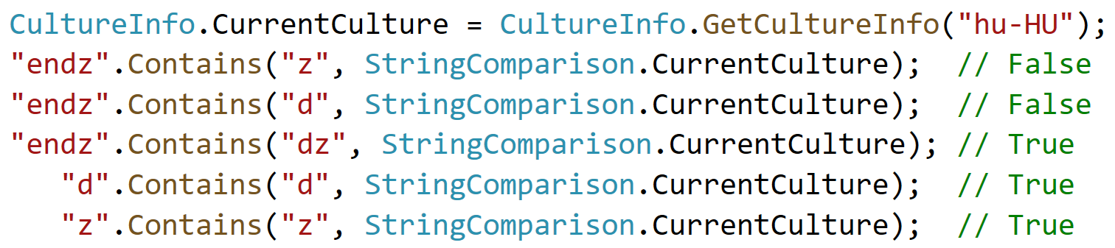
String comparison examples
In Hungarian, “dz” is considered as a digraph (U+01F3)

Slide 22
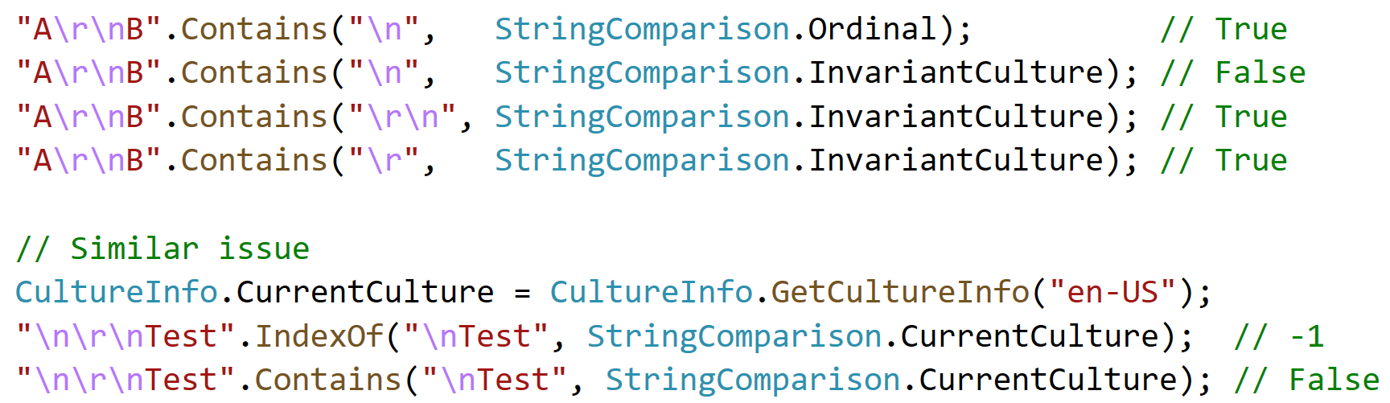
String comparison examples

Slide 23
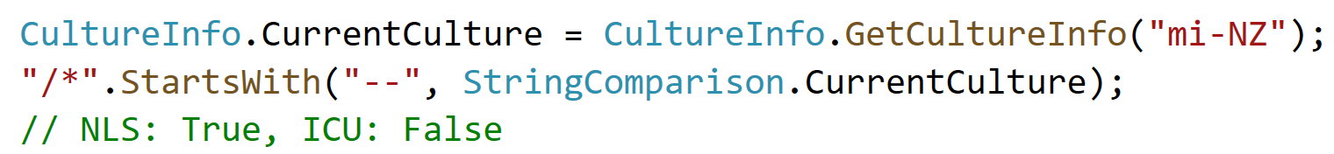
String comparison examples

Slide 24
String comparison examples
True when using NLS
False when using ICU

Slide 25
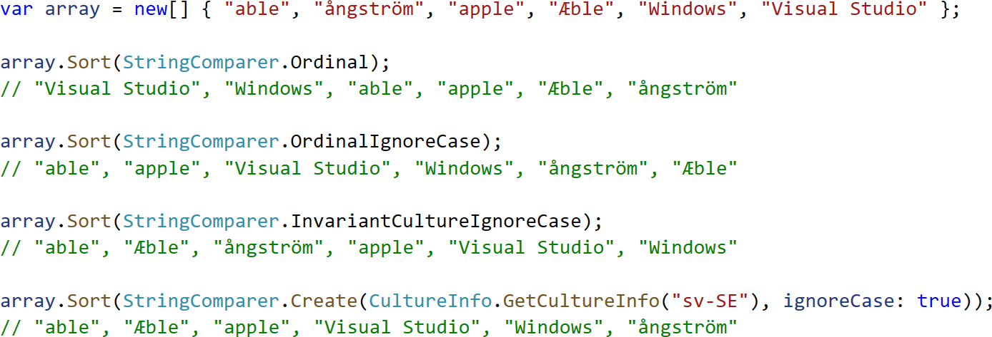
String comparison examples

Slide 26
Keep in simple… or not ☹

Slide 27
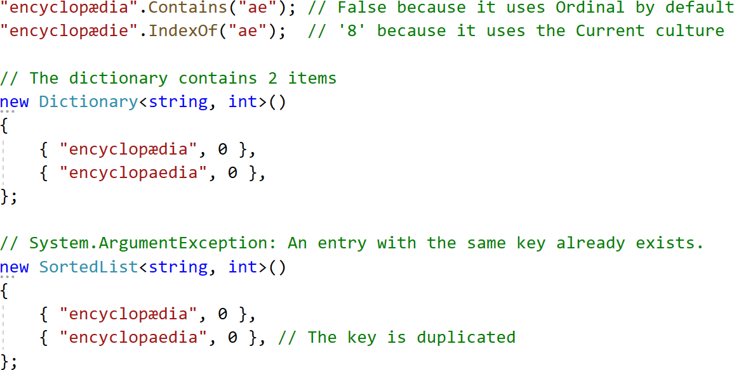
Methods have different default modes

Slide 28
Methods have different default modes

Slide 29
How to avoid problems
Always use an overload with a parameter of type:
  ComparisonMode
  IComparer<string>
  IEqualityComparer<string>

Slide 30
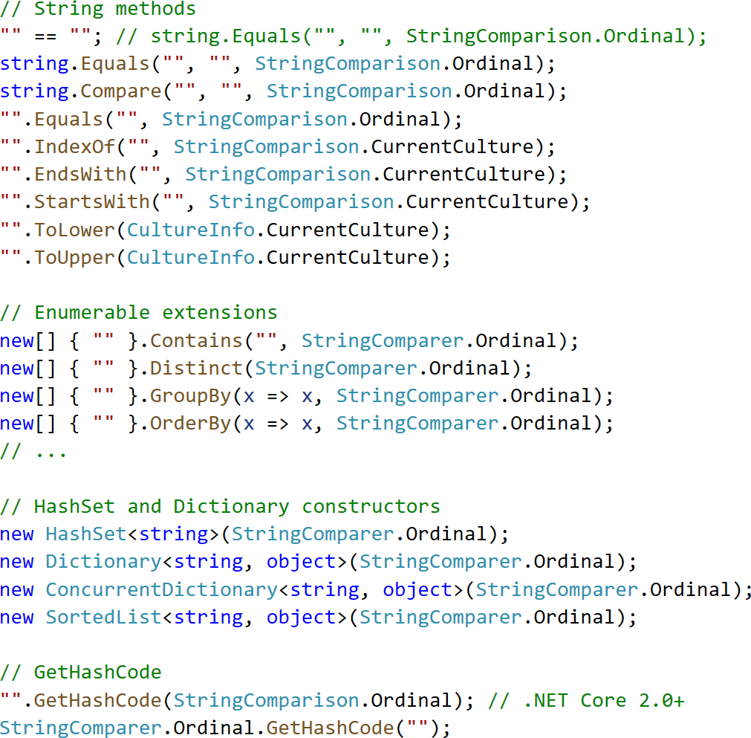

Slide 31
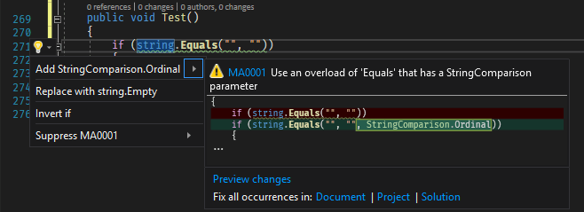
How to avoid problems
Use Roslyn Analyzers (EnableNETAnalyzers or Meziantou.Analyzer)
<PropertyGroup>
<EnableNETAnalyzers>true</EnableNETAnalyzers>
</PropertyGroup>

Slide 32
String formatting / parsing

Slide 33
Globalization
Cultures define info for formatting / parsing data
  Date and time formats
  Number formats
  Currency symbol
  List separator
  Etc.
Invariant culture data are hard-coded and constant
  Useful for persisting data

Slide 34
Many methods use the current culture
  String.Format(), FormattableString.ToString(), $"{value}"
  int.ToString(), decimal.ToString(), etc.
  StringBuilder.Append(int)
  int.Parse()
  ⚠ Negative symbol can be problematic
    -1 (https://unicode-table.com/en/002D/)
    −1 (https://unicode-table.com/en/2212/)
Be sure to use InvariantCulture when needed
Notes:
-1 (https://unicode-table.com/en/002D/)
−1 (https://unicode-table.com/en/2212/)
https://github.com/dotnet/roslyn/issues/49826#issuecomment-739813166

Slide 35
Conclusion

Slide 36
Conclusion
Use Rune instead of char when you handle unknown characters
Always specify StringComparison / StringComparer
  Most of the time you want Ordinal/OrdinalIgnoreCase
Use InvariantCulture to persist data
Use CurrentCulture to display data to the user
Be careful with methods that implicitly use the current culture

Slide 37
Bonus

Slide 38
Regex
new Regex("[0-9]") => Match 10 characters
new Regex("\d") => Match more than 600 characters
new Regex("\d", RegexOptions.ECMAScript)
Notes:
-1 (https://unicode-table.com/en/002D/)
−1 (https://unicode-table.com/en/2212/)
https://github.com/dotnet/roslyn/issues/49826#issuecomment-739813166

Slide 39
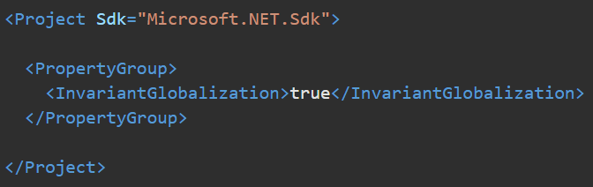
Invariant mode
CultureInfo.Get("whatever") => InvariantCulture
OrdinalIgnoreCase removes support for non-ascii
Notes:
-1 (https://unicode-table.com/en/002D/)
−1 (https://unicode-table.com/en/2212/)
https://github.com/dotnet/roslyn/issues/49826#issuecomment-739813166

Slide 40
Want’s more?
NET globalization and ICU
Best practices for comparing strings in .NET
Locale (Culture) Data Churn
How to correctly count the number of characters of a string
String comparisons are harder than it seems
.NET Regex: \d is different from [0-9]
Enable or install first-party .NET analyzers
https://github.com/dotnet/runtime/issues?q=is%3Aissue+ICU

