Slide 1

Date and Time
Gérald Barré
Website: https://www.meziantou.net
Twitter: @meziantou

Slide 2
1 minute = 60s ?
1 hour = 60 minutes ?
1 day = 23, 24, or 25 hours ?
24:12:34 is an invalid time ?
A year starts on January 1 ?
DateTime.UtcNow is monotonic ?

Slide 3
.NET types
DateTime (Parsing, Formatting, Comparison, etc.)
DateTimeKind (Unspecified, Local, Utc)
DateTimeOffset (DateTime + TimeSpan)
DateOnly
TimeOnly
DayOfWeek
TimeZone / TimeZoneInfo
ISOWeek
Calendar
CultureInfo
  Calendar, DateTimeFormat, OptionalCalendars
Stopwatch

Slide 4
Multiple calendars
  System.Globalization.EastAsianLunisolarCalendar
  System.Globalization.GregorianCalendar
  System.Globalization.HebrewCalendar
  System.Globalization.HijriCalendar
  System.Globalization.JapaneseCalendar
  System.Globalization.JulianCalendar
  System.Globalization.KoreanCalendar
  System.Globalization.PersianCalendar
  System.Globalization.TaiwanCalendar
  System.Globalization.ThaiBuddhistCalendar
  System.Globalization.UmAlQuraCalendar

Slide 5
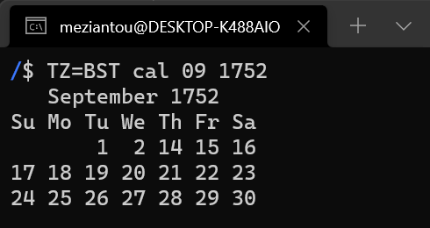
Multiple calendars
Julian → Gregorian: ≈1582-1920
Gregorian calendar ≠ ISO8601
  ISO8601 uses Proleptic Gregorian calendar
Days may be non-consecutive

Slide 6
Calendar
var dt = new DateTime(1917, 10, 25,
new JulianCalendar());
Console.WriteLine(dt); // Nov. 7, 1917
new JulianCalendar().GetDayOfYear(dt);

Slide 7
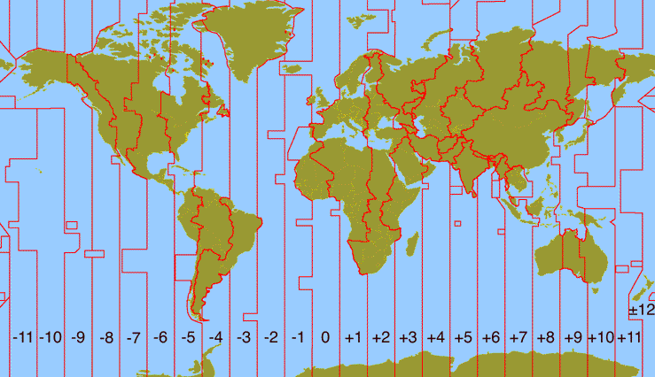
Time zones

Slide 8
Time zones
From -12:00 to +14:00
Offset can contain minutes (15, 30, 45 minutes) (and even seconds for old dates)
Different names for time zones
  IANA: America/New_York
  Windows: Eastern Standard Time
    Before .NET 6, use TimeZoneConverter package to use both format
A country can have multiple time zones
  Example: France 12, Russia: 11, Antarctica: 10, China: 1
Daylight saving time (DST)
  Not for all time zones
  Not on the same day / time
  Not always 1 hour (Antarctica/Troll: 2 hours, Australia/Lord_Howe: 30 minutes)
Some dates are ambiguous or invalid
  TimeZoneInfo.FindSystemTimeZoneById("Pacific/Apia").IsInvalidTime(new DateTime(2011, 12, 30))
Notes:
https://devblogs.microsoft.com/dotnet/cross-platform-time-zones-with-net-core/

Slide 9
Time zones
Time zones = geography political🤪
Time zone info can change at any moment (and they do😢)
  In 2007, Venezuela's president shifted the entire country back 30 minutes
  December 30th, 2011, doesn’t exist in Samoa
  Cuba moved the switch to DST from 11-Mar-2012 to 01-Apr-2012
  And many more examples (tzdata is > 260kb gzipped)
Don’t expect long notice period
  sometimes less than a day

Slide 10
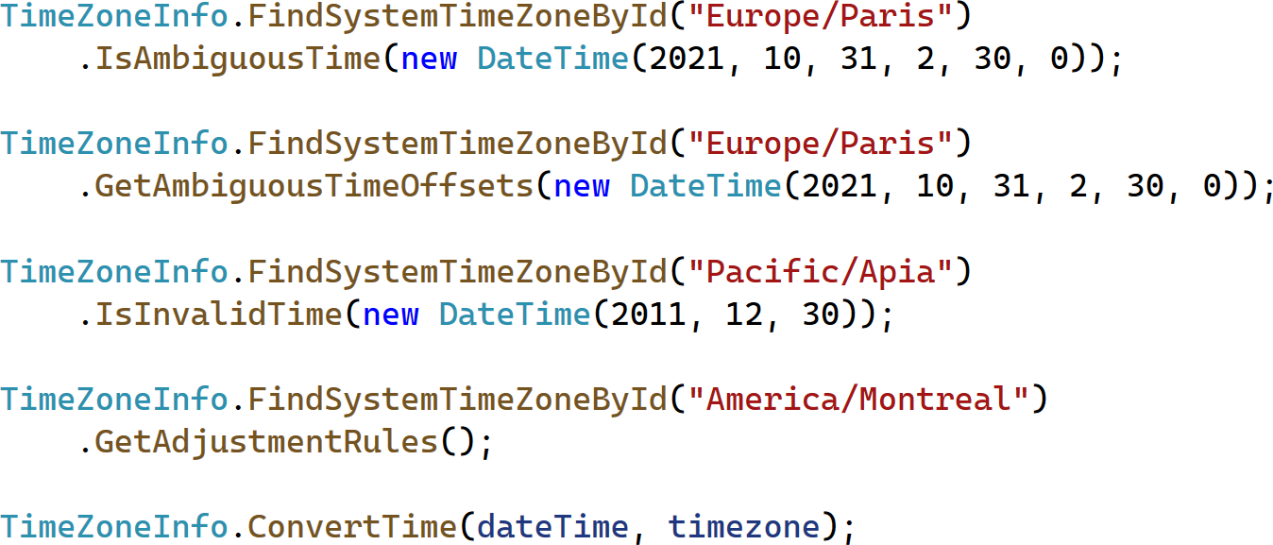
Time zones
Notes:
var dateTime = new DateTime();
var timezone = TimeZoneInfo.GetSystemTimeZones()[0];
TimeZoneInfo.FindSystemTimeZoneById("Europe/Paris")
.IsAmbiguousTime(new DateTime(2021, 10, 31, 2, 30, 0));
TimeZoneInfo.FindSystemTimeZoneById("Europe/Paris")
.GetAmbiguousTimeOffsets(new DateTime(2021, 10, 31, 2, 30, 0));
TimeZoneInfo.FindSystemTimeZoneById("Pacific/Apia")
.IsInvalidTime(new DateTime(2011, 12, 30));
TimeZoneInfo.FindSystemTimeZoneById("America/Montreal")
.GetAdjustmentRules();
TimeZoneInfo.ConvertTime(dateTime, timezone);

Slide 11
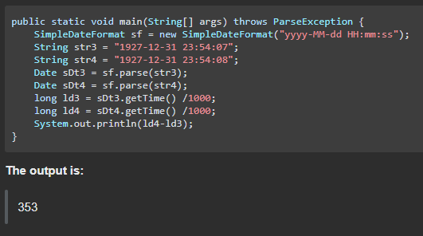
Time zones
https://stackoverflow.com/questions/6841333/why-is-subtracting-these-two-times-in-1927-giving-a-strange-result

Slide 12
Time zones
Use Noda Time!
Noda Time: What's wrong with DateTime anyway?

Slide 13
Parsing
DateTime.Parse("2022-01-02T04:11:43.888Z");
// return a local date (e.g. 1/1/2022 11:11:43 PM)
DateTime.Parse("2022-01-02T04:11:43.888Z", provider: null, DateTimeStyles.AdjustToUniversal);
// return a UTC date (e.g. 1/2/2022 11:11:43 PM)

Slide 14

UTC != GMT
GMT: Greenwich Mean Time => Time zone UTC+0 (standard prior to 1972)
UTC: Coordinated Universal Time => time standard
  Based on International Atomic Time (TAI) and Universal Time (UT1)
  More precise than the previous standard
Earth's Daily Rotation Slowing
  Introduce a leap second to synchronize GMT and UTC
  About 1 leap second every 19 months
  GMT and UTC may differ by maximum 0.9s
December 31, 2005 23:59:60 UTC

Slide 15
UTC is not a silver bullet
Works great for instants <= Now
What if you want to organize an event next year at 9AM?
  Will the country still use the same offset?
  What about DST?

Slide 16
Leap year
Multiple of 4, except for years evenly divisible by 100, unless evenly divisible by 400
DateTime.IsLeapYear(2020)
DateTime.DaysInMonth(2020, 2)
DateTime.Add(…), DateTime.AddDays(…)
Fun fact: February 30th, 1712, is valid in Sweden

Slide 17
Leap year - Bugs?
var birthday = new DateTime(…);
var isBirthday = DateTime.UtcNow.Date == new DateTime(DateTime.UtcNow.Year, birthday.Month, birthday.Day);
var dt = new DateTime(…);
var nextYear = new DateTime(dt.Year + 1, dt.Month, dt.Day);

Slide 18
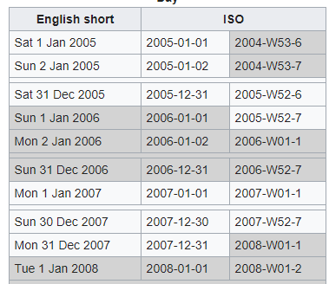
ISO Week
Week 01 is the week with the first Thursday of the Gregorian year
An ISO week-numbering year has 52 or 53 full weeks
  364 or 371 days
ISOWeek.GetYear(DateTime)
ISOWeek.GetWeekOfYear(DateTime)
ISOWeek.GetYearStart(Int32)
ISOWeek.GetYearEnd(Int32)

Slide 19
Cultural differences
Start of week: Sunday; Monday
Weekend: Saturday-Sunday; Friday-Saturday; Friday; etc.
Day start: Midnight; when the moon comes out

Slide 20
How to synchronize time?
Network Time Protocol (NTP)
What about the request roundtrip time? Network congestion?
Stability?
Can NTP drift the clock backwards?
Precision: ≈1ms accuracy with regard to UTC across a domain
Notes:
https://docs.microsoft.com/en-us/windows-server/networking/windows-time-service/windows-server-2016-improvements
https://techcommunity.microsoft.com/t5/networking-blog/top-10-networking-features-in-windows-server-2019-10-accurate/ba-p/339739
https://techcommunity.microsoft.com/t5/networking-blog/windows-subsystem-for-linux-for-testing-windows-10-ptp-client/ba-p/389181
https://techcommunity.microsoft.com/t5/networking-blog/evolution-of-timekeeping-in-windows/ba-p/778020

Slide 21
Measure elapsed time
❌var start = DateTime.Now;
var elapsedTime = DateTime.Now - start;
❌var start = DateTime.UtcNow;
var elapsedTime = DateTime.UtcNow - start;
✔️var stopwatch = Stopwatch.StartNew();
var elapsedTime = stopwatch.ElapsedTime;

Slide 22
Formatting
O (ISO8601): yyyy'-'MM'-'dd'T'HH':'mm':'ss'.'fffffffK
R (RFC1123): ddd, dd MMM yyyy HH':'mm':'ss 'GMT'
S (sortable): yyyy'-'MM'-'dd'T'HH':'mm':'ss
Standard date and time format strings | Microsoft Docs
Custom date and time format strings | Microsoft Docs
⚠️Format depends on the library
  Some JS libs: yyyy vs YYYY (year vs ISO Year)
  Formatting Date & Time – amCharts 4 Documentation

Slide 23
Conclusion
Time zone ≠ offset
1 year ≠ 365 or 366 days
1 day ≠ 24hours
1 hour ≠ 60 minutes
1 minute ≠ 60 seconds
Daylight saving time ≠ ±1 hour
Time zone = Political
DateTime.UtcNow is not monotonic
Cultural differences
Understand your needs and use the right thing!

